Slide 1

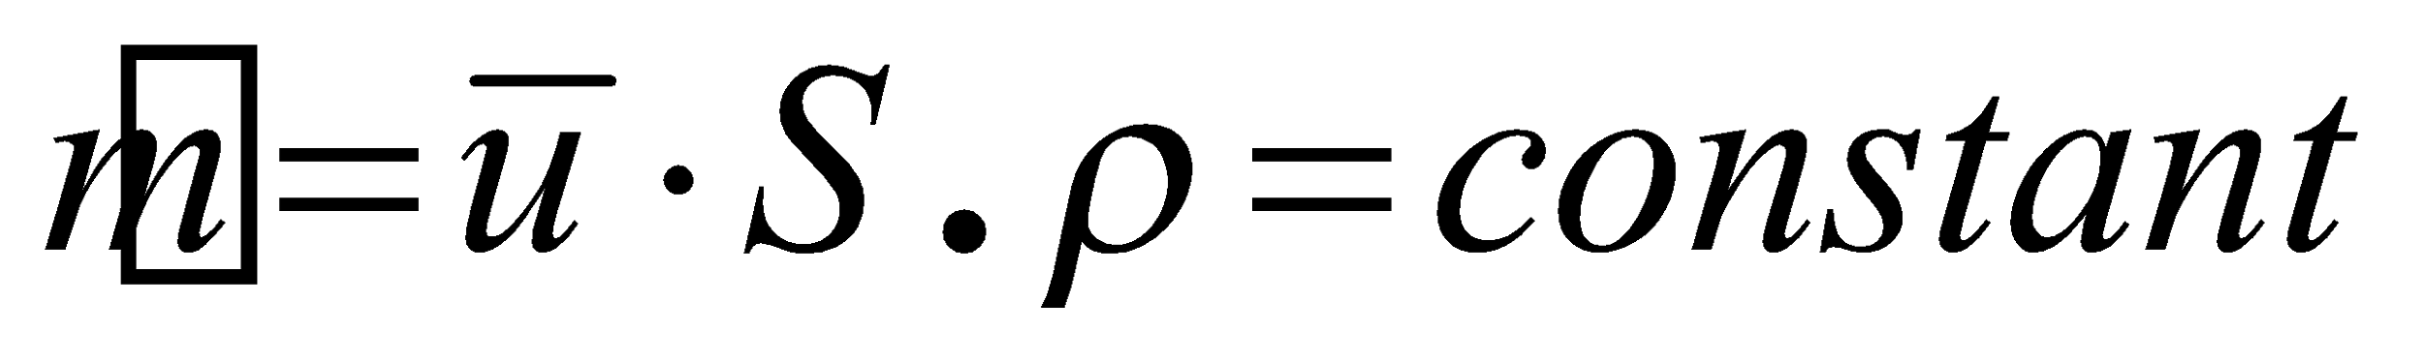
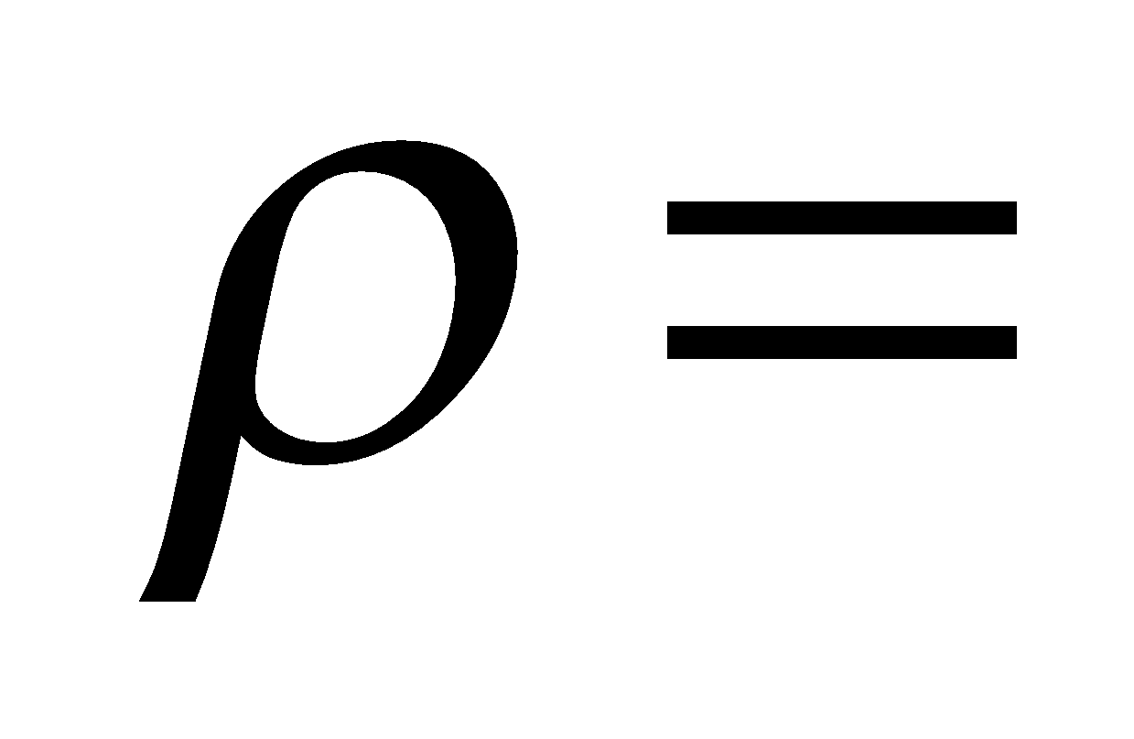

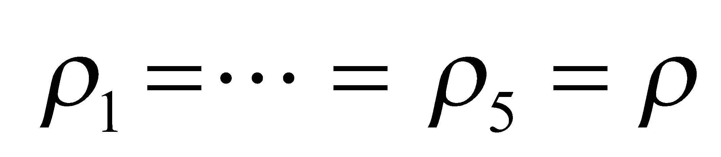
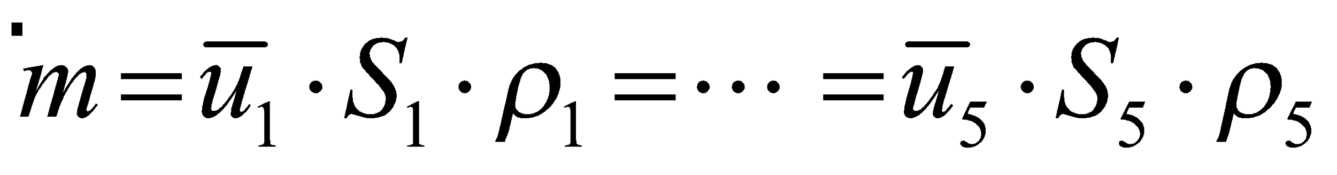
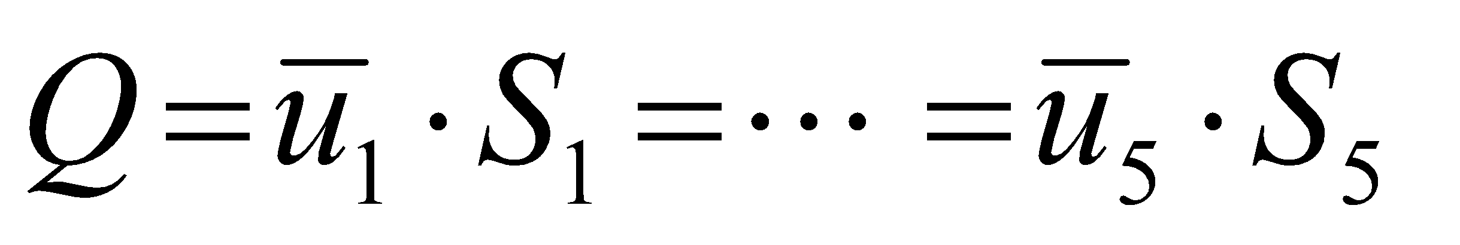
MECHANICAL ENERGY BALANCE
Continuity Equation
Mass per Unit of Time is constant e.g kg/s
S₁
Mass flow rate
S₂
Density
Area
Mean velocity of fluid
For incompressible fluids ( constant)
S₃
S₄
S₅

Slide 2
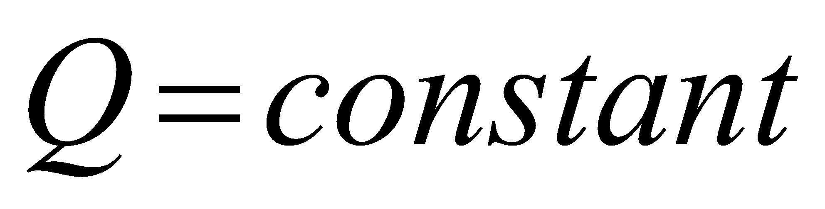
S₁
Volumetric Flow (m³/s)
S₂
For Incompressible Fluid
S₃
S₄
S₅
Continuity Equation

Slide 3
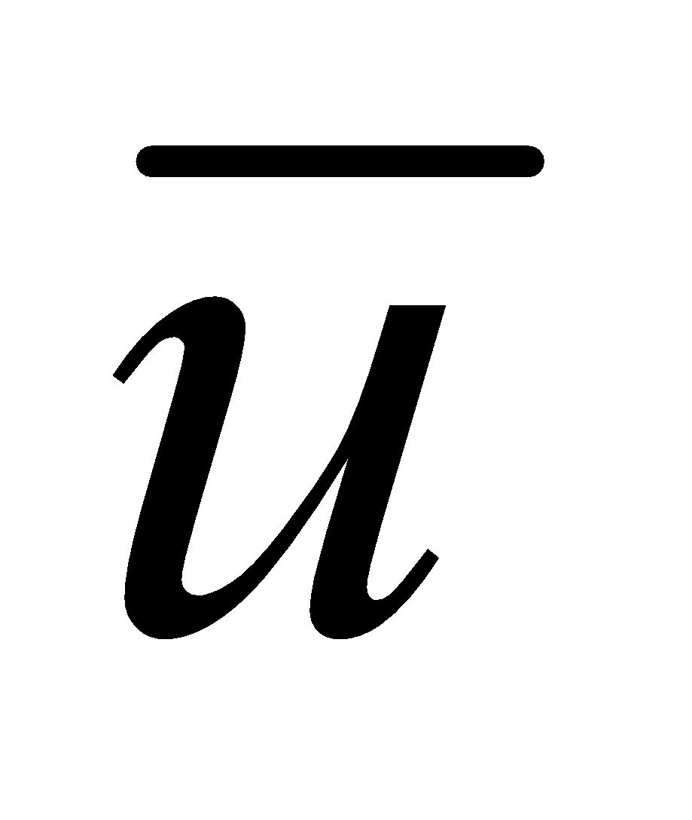
Continuity Equation
Concept of Mean Fluid Velocity
r
z
Velocity Profile V_{z}(r)
Function of Rheology

Slide 4
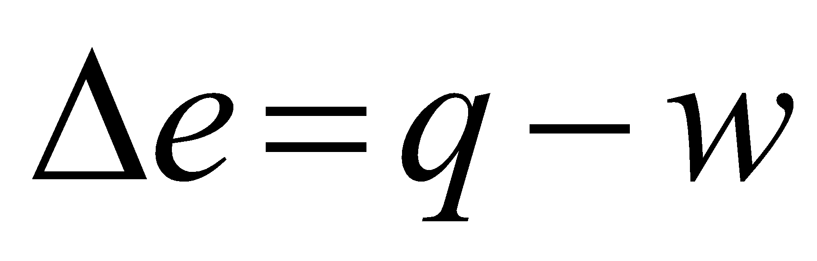
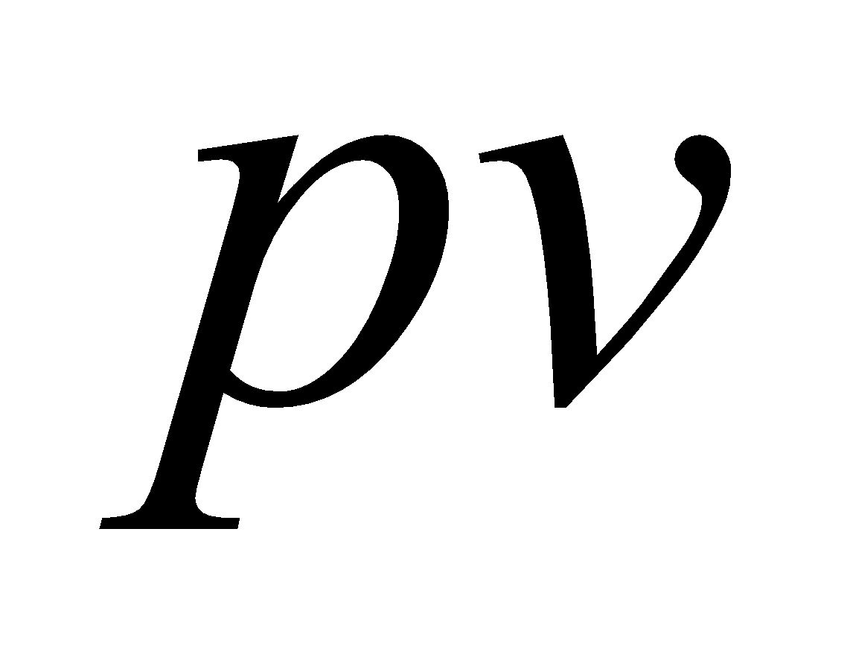
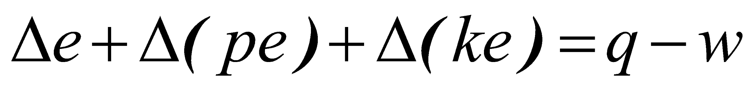

Energy Balance
Batch Processes
Internal Energy
Heat
Work
Continuous (Flow) Processes
Flow Work
Shaft Work
Internal Energy
Kinetic Energy
Potential Energy
Total Energy

Slide 5
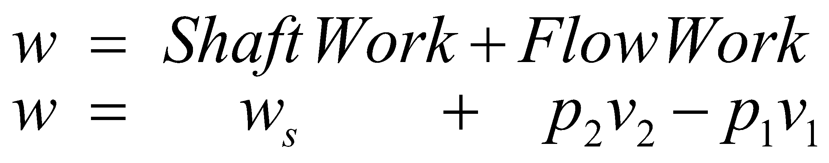
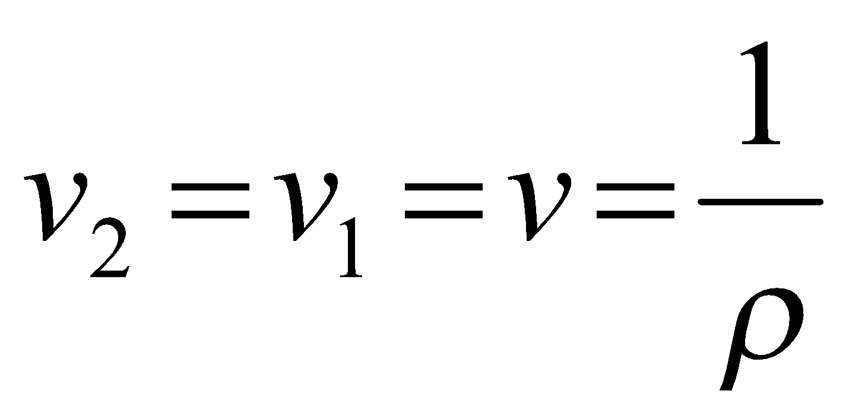
Energy Balance
Concept of Shaft and Flow Work
w_{s}
1
Pump
2
P₁v₁
P₂v₂
Work (-)
System
For incompressible fluids
Work (+)
Specific Volume of fluid

Slide 6
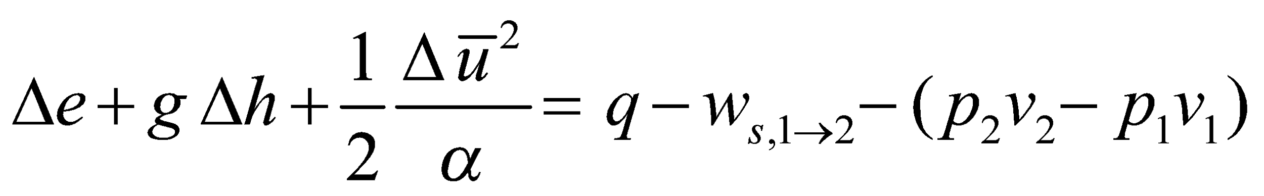
Mechanical Energy Balance
w_{s}
1
2
P₁v₁
P₂v₂
To take into account
the velocity profile

Slide 7

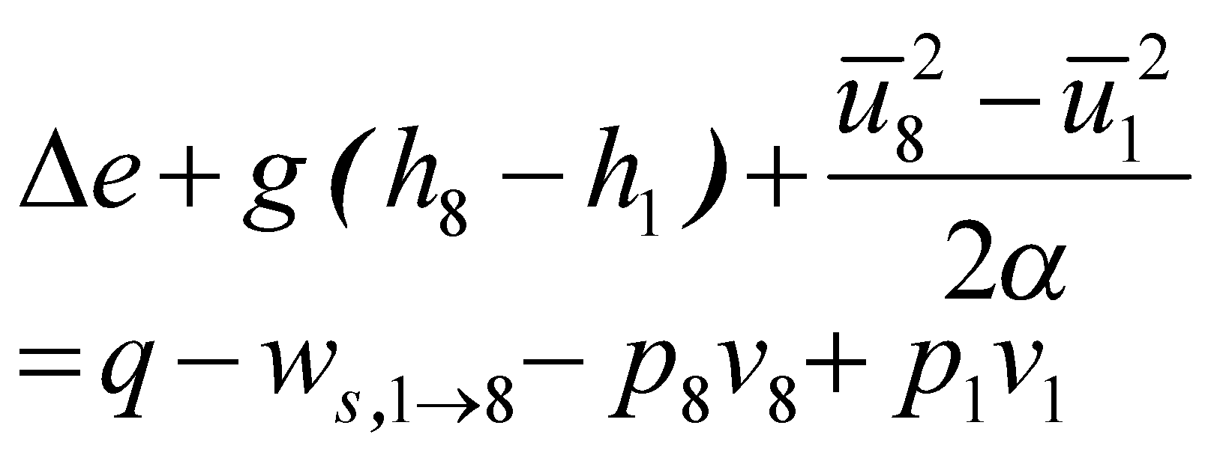
Energy Balance
Coefficient that takes into
account the conversion
between a local velocity
profile and mean velocity
8
7
Service
Liquid
Pump
6
h₈
3
5
4
1
-w_{s}
2
Pump
h₁
Process Liquid
Datum Level

Slide 8
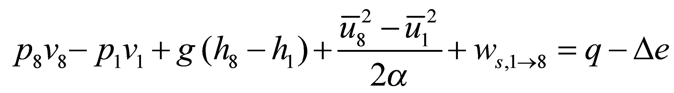

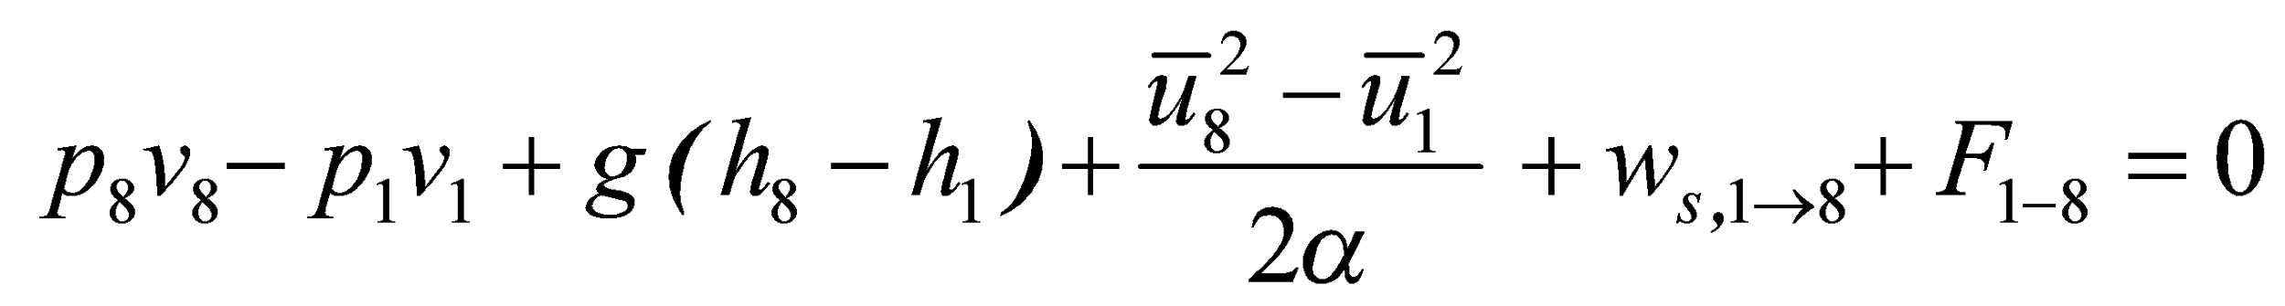
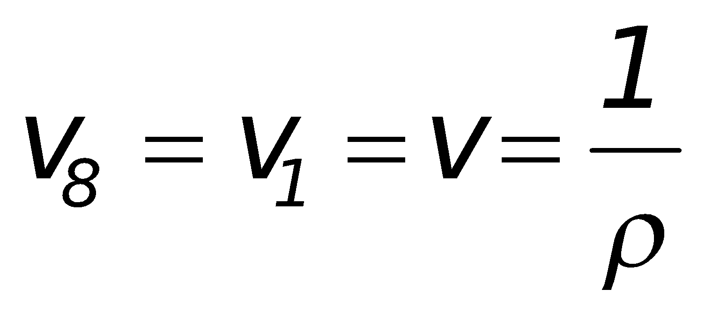
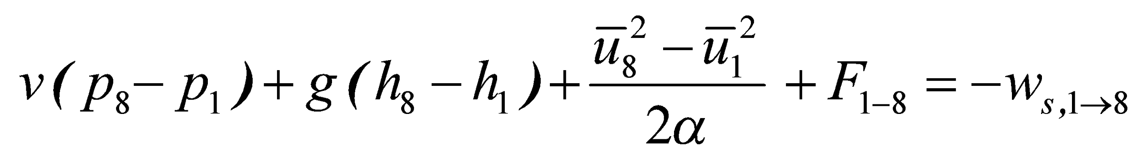
Overall Mechanical Energy Balance
For a mechanical balance we do not consider internal
energy and heat (isothermal processes)
For an incompressible
fluid
Heat Generated by
Friction (Loss in the system)

Slide 9
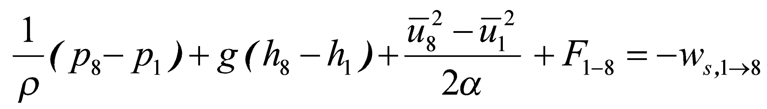

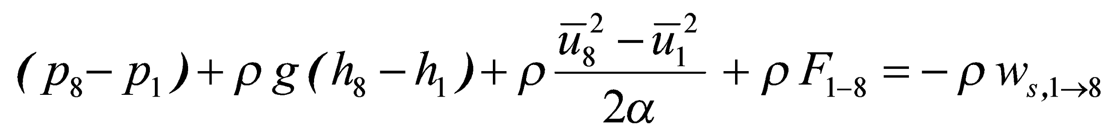
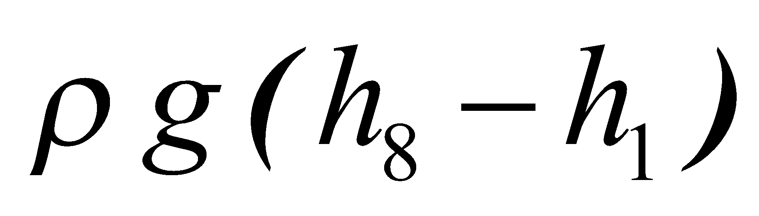
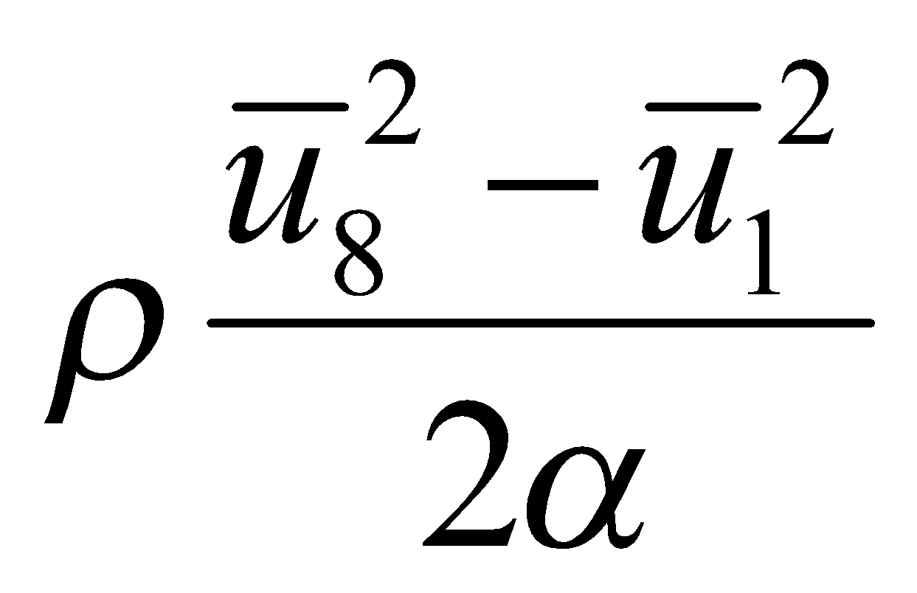
Overall Mechanical Energy Balance
multiply equation by
Pascal
Pascal
Pascal
Pascal
Function of Rheology

Slide 10
Overall Mechanical Energy Balance
7
8
Service
Liquid
Pump
6
h₈
3
5
4
1
-w_{s}
2
Pump
h₁
Process Liquid
Datum Level

Slide 11
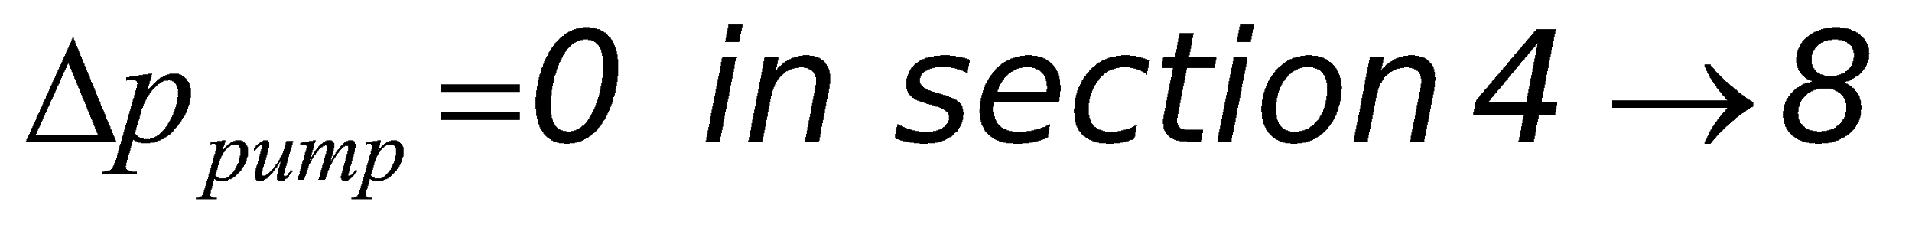
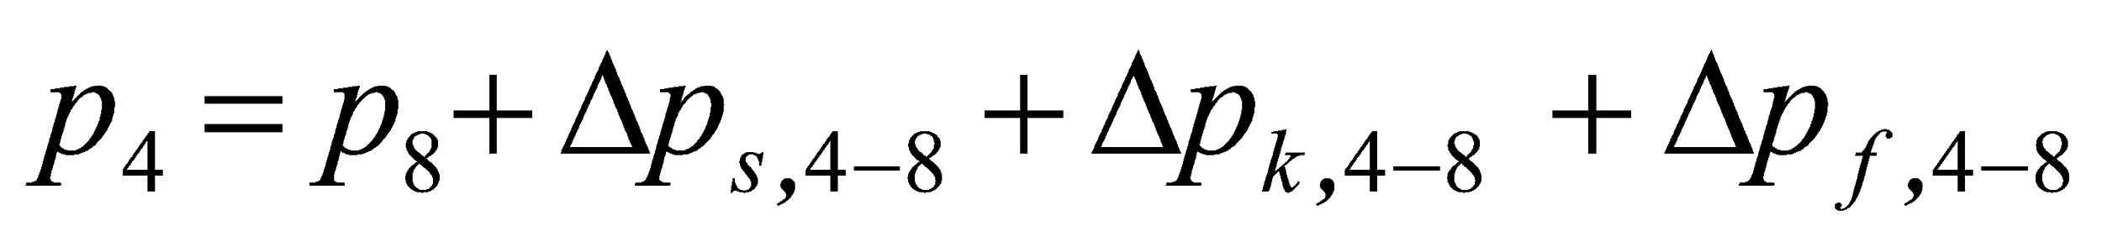
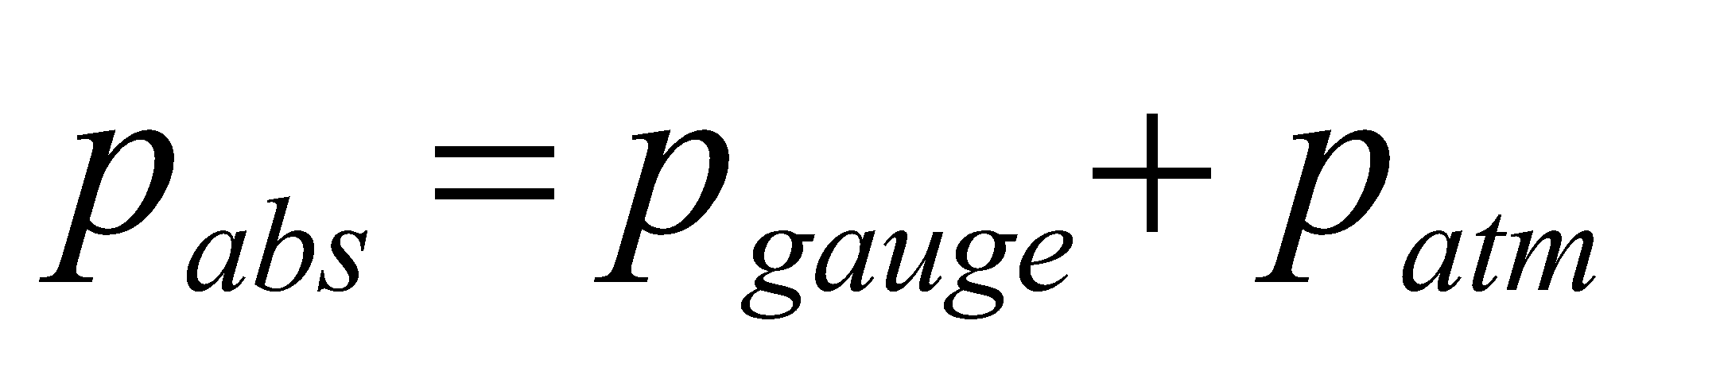
Calculation of pump discharge p₄
7
8
Service
Liquid
Pump
6
h₈
3
4
5
1
2
Pump
h₄
In general pressures are expressed
as gauge pressures
h₁
Process Liquid
Datum Level

Slide 12
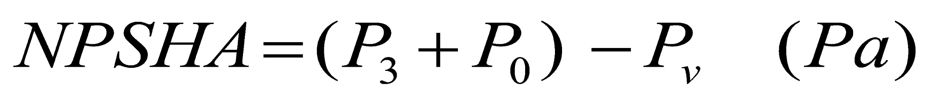
Relationship between NPSHR, NPSHA and P_{v}
Actual Pump suction
side pressure (P₃)
Minimum Permissible
pump suction side
pressure
NPSHA
Absolute Pressure (Pa)
NPSH : Net Positive Suction Height
NPSHR
P_{v}
0
P₃ : Pump Suction pressure
P_{o} : atmospheric Pressure (101.3x10³ Pa)
P_{v} : Liquid’s saturated vapor pressure at pumping temperature

Slide 13
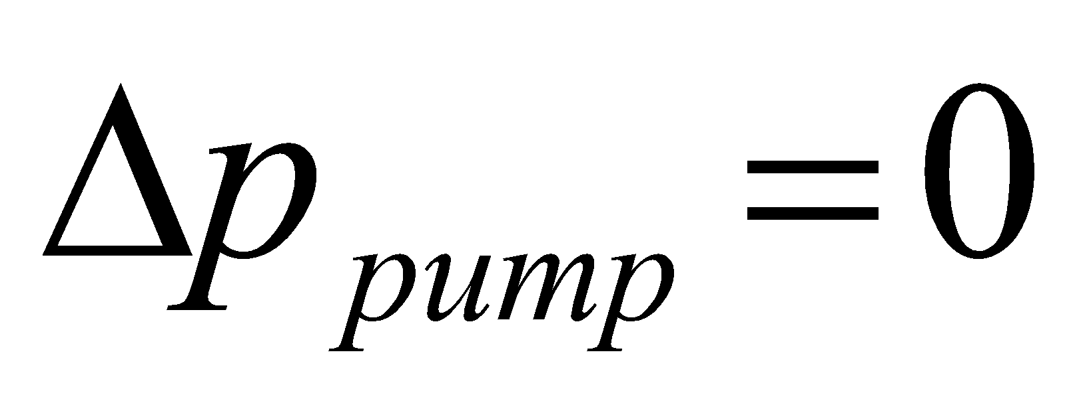
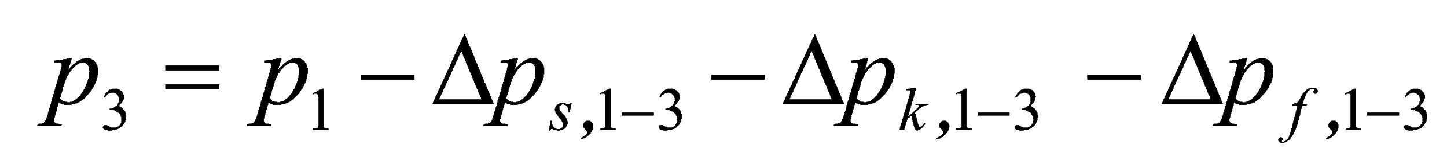
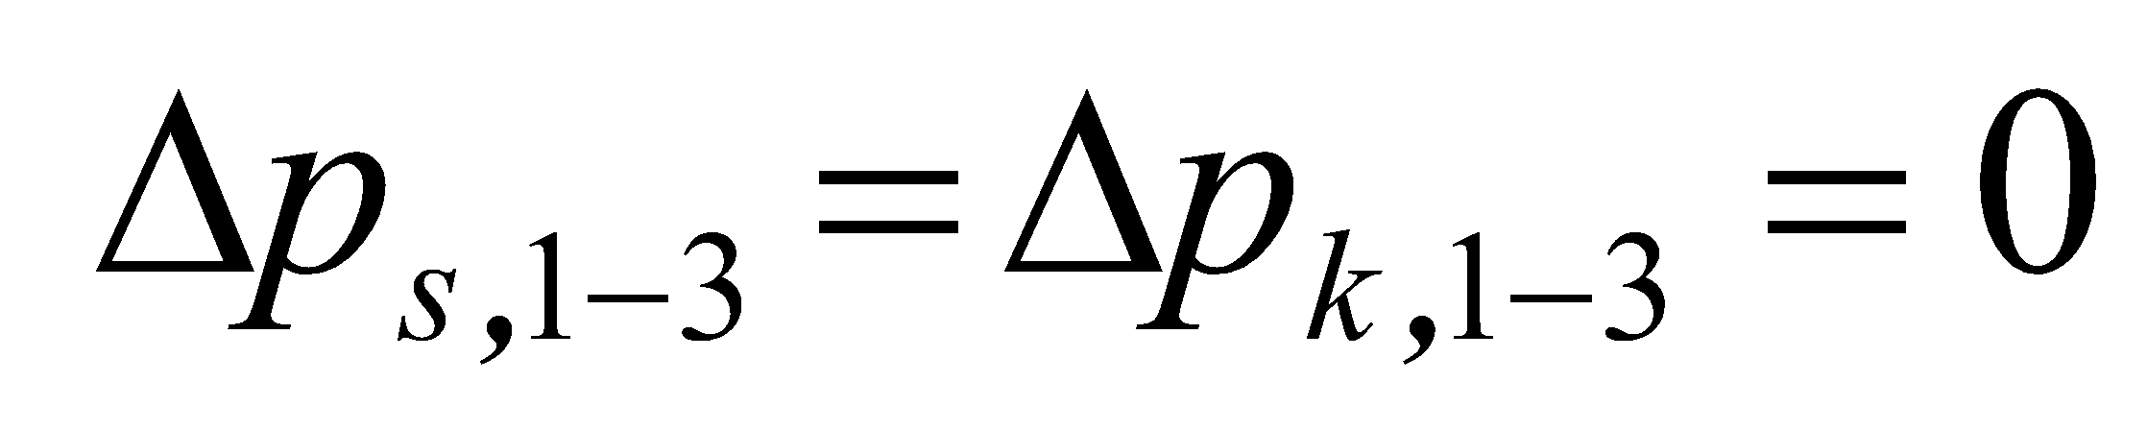
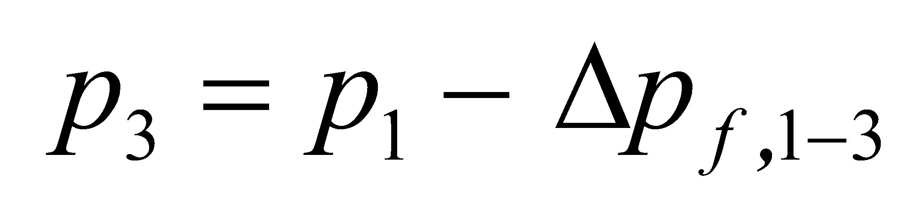
Suction Pressure p₃
7
8
Balance between 1 and 3
Service
Liquid
Pump
6
h₈
3
4
5
1
2
Pump
h₁
Process Liquid
Datum Level
Assume that
Function of rheology and “system”

Slide 14
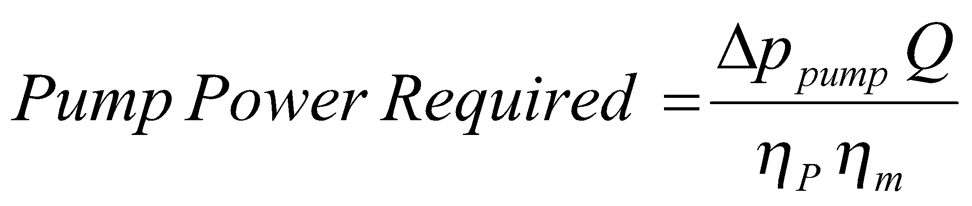
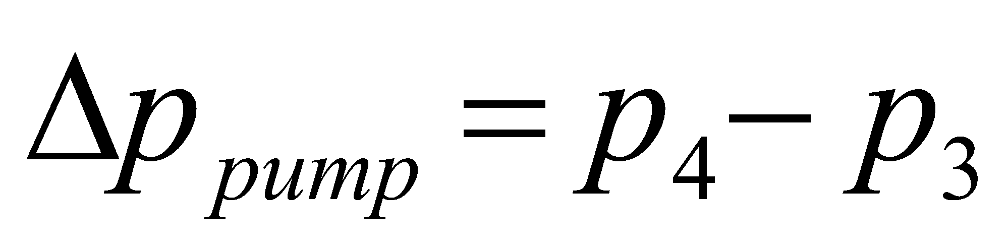
Pumping Power from Suction
and Discharge Pressures
4
3
= 0 no change
in height
= 0 no change
in fluid velocity
= 0 friction
is incorporated
in the pump
efficiency

Slide 15
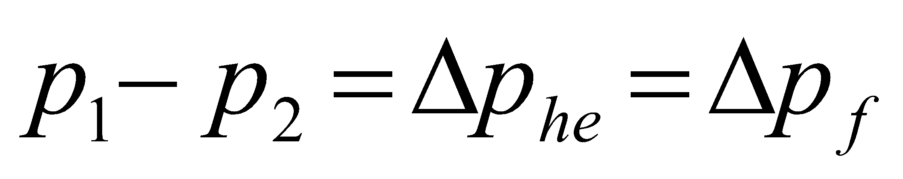
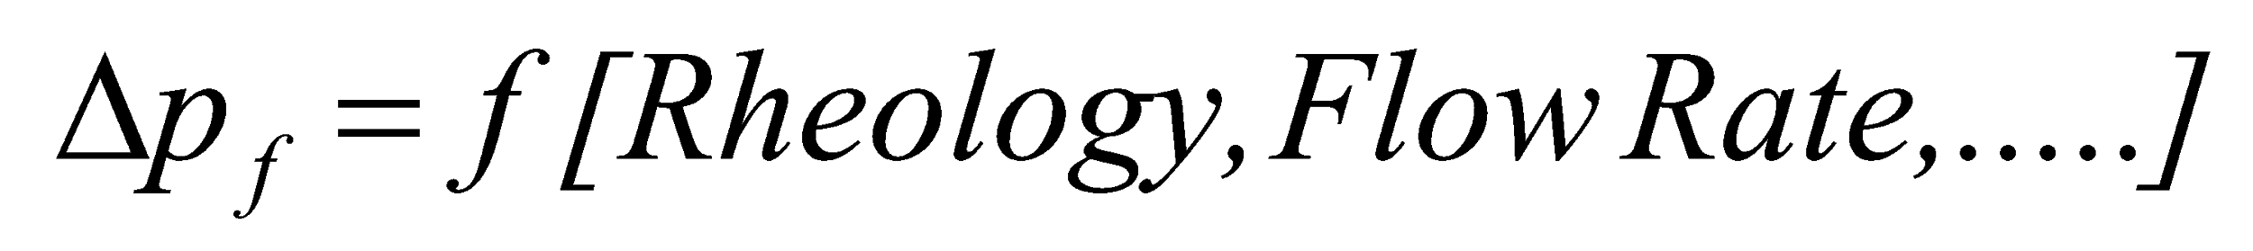
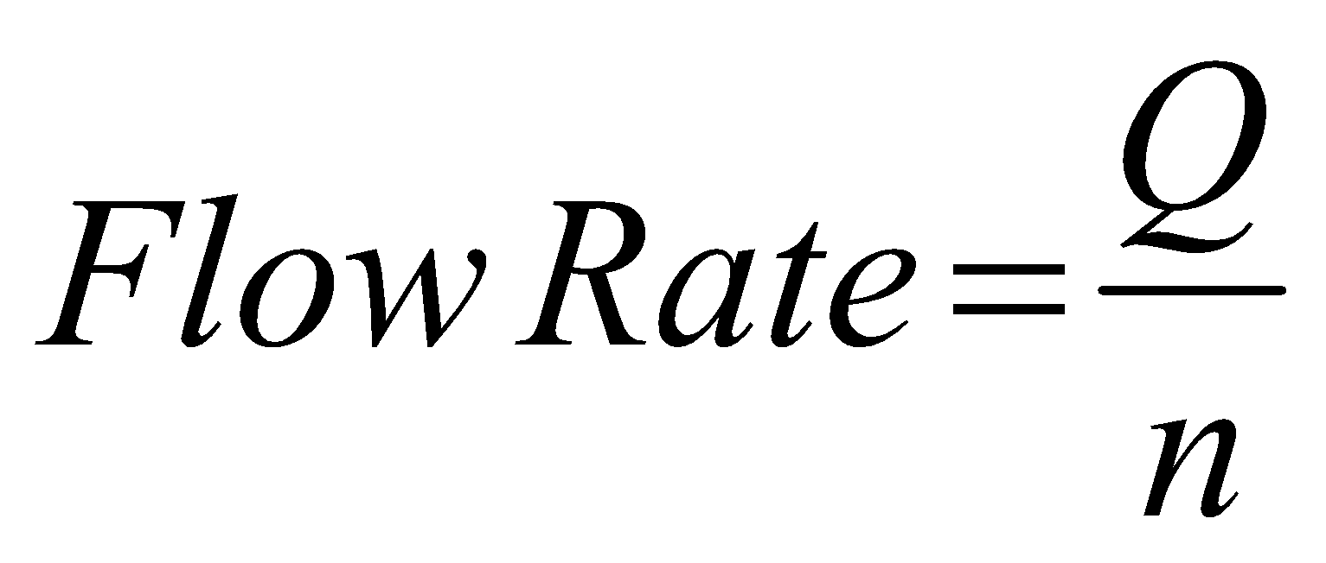
Pressure Loss in Heat Exchangers
n channels
with flow
q_{n}=Q/n
1
2
Flow Rate ?

Slide 16
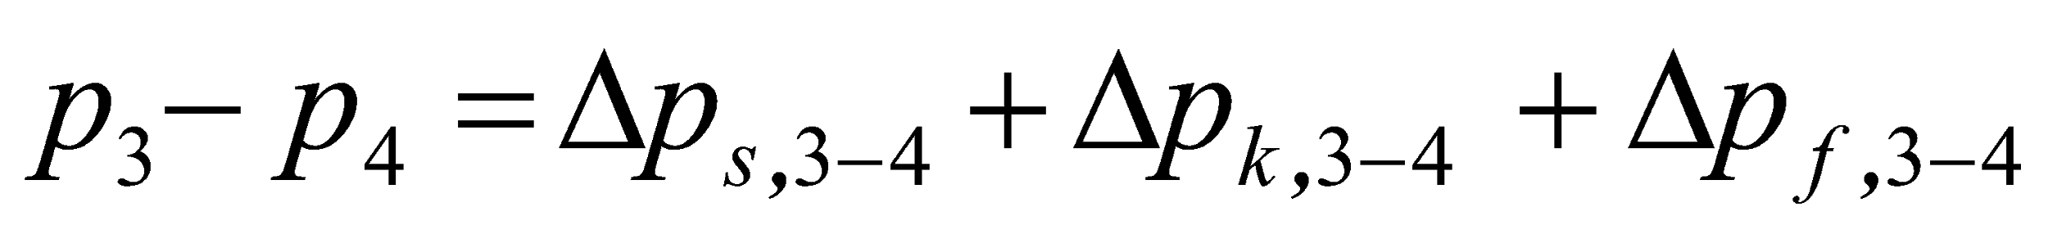
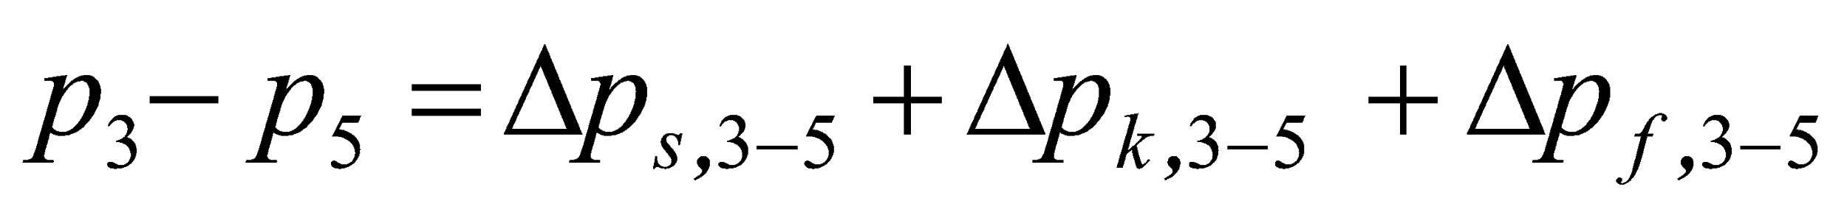
Branched Pipelines
4
2
1
3
5
3-4
3-5
1-3

Slide 17
5
2
3
1
4
Branched Pipeline with Recycle Loop

Slide 18
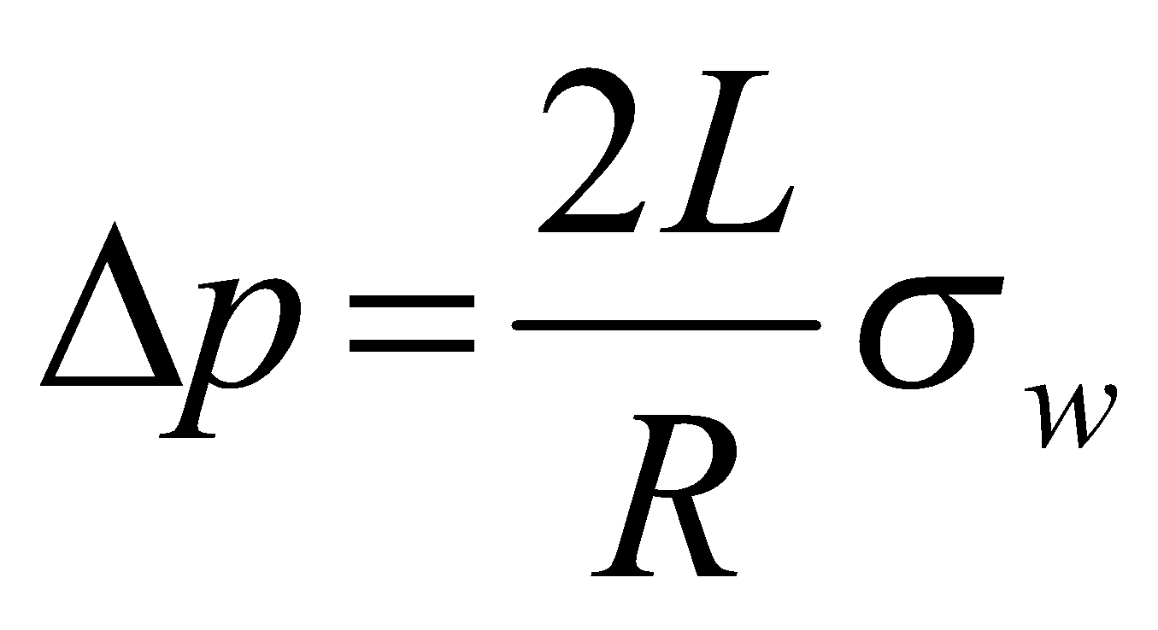
Calculation of pressure loss by friction
Pressure
Forces
Friction
Forces
R
L

Slide 19
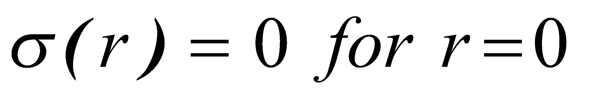
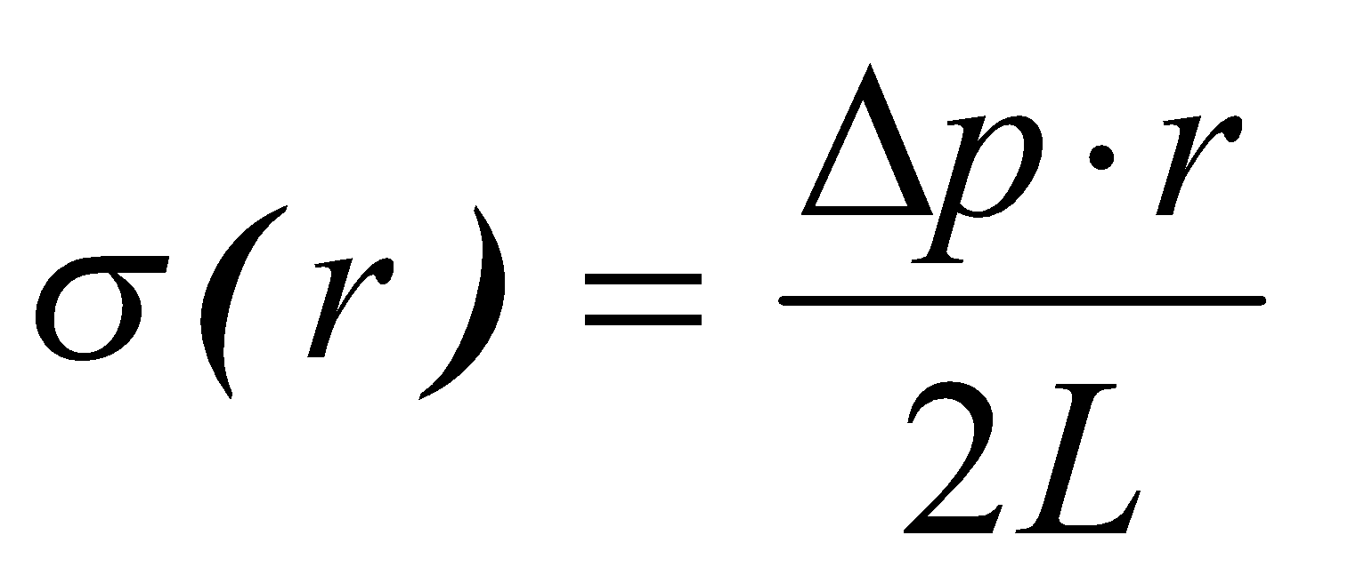
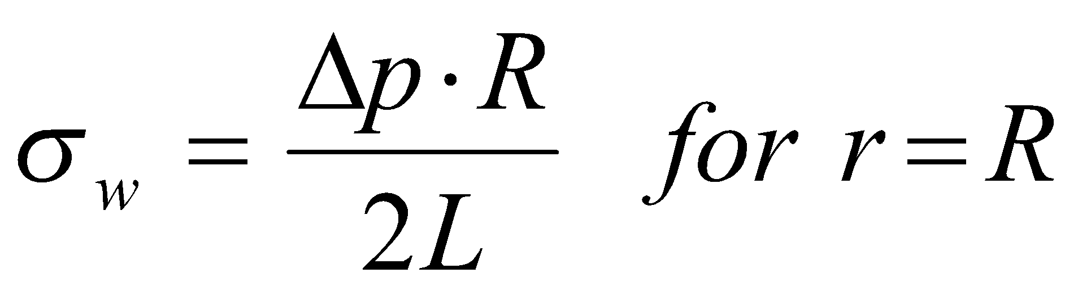
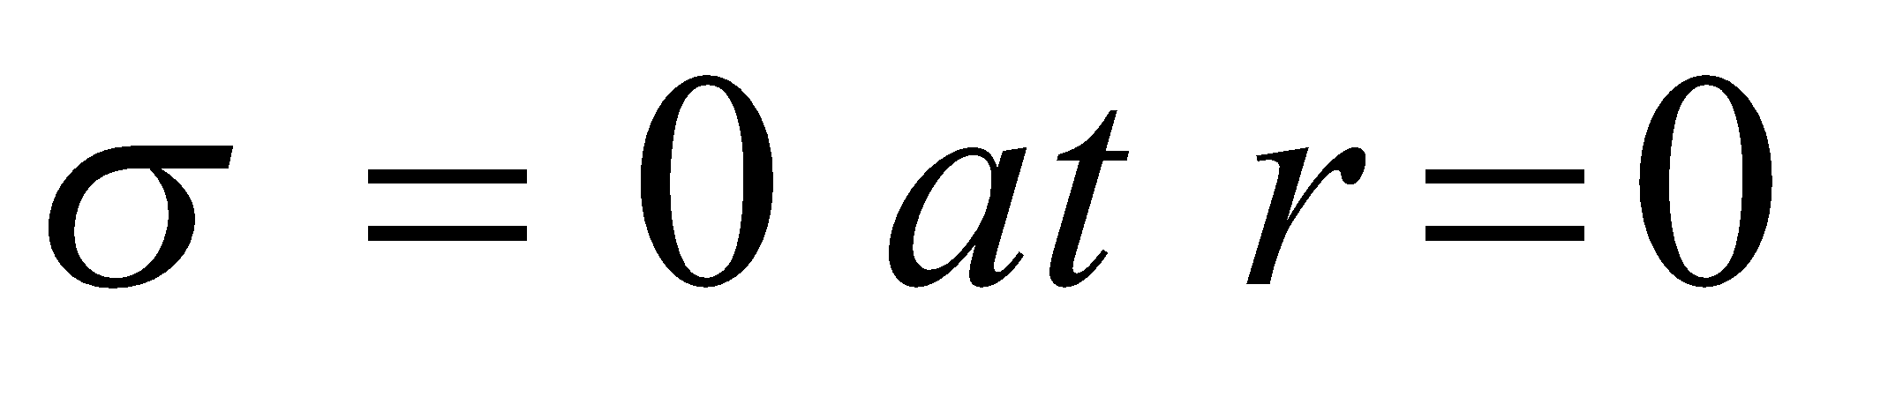
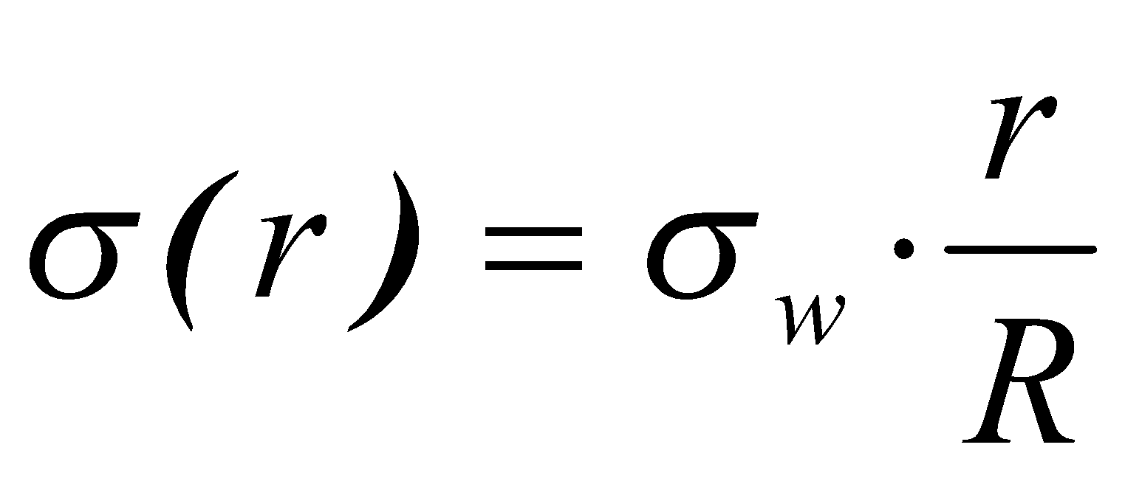
Shear Stress Profile
r
R
L

Slide 20
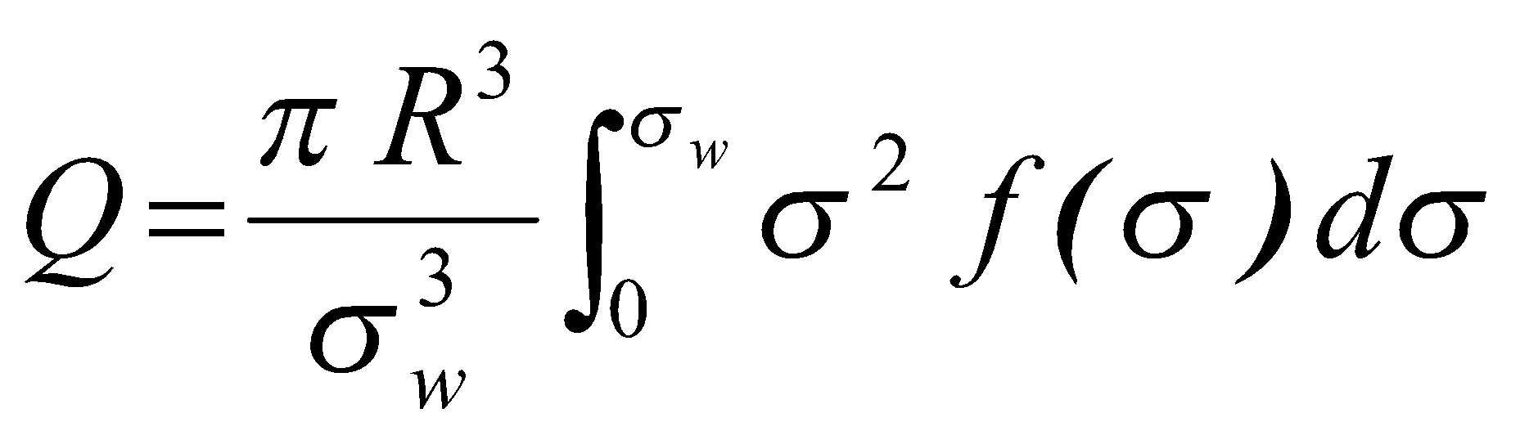
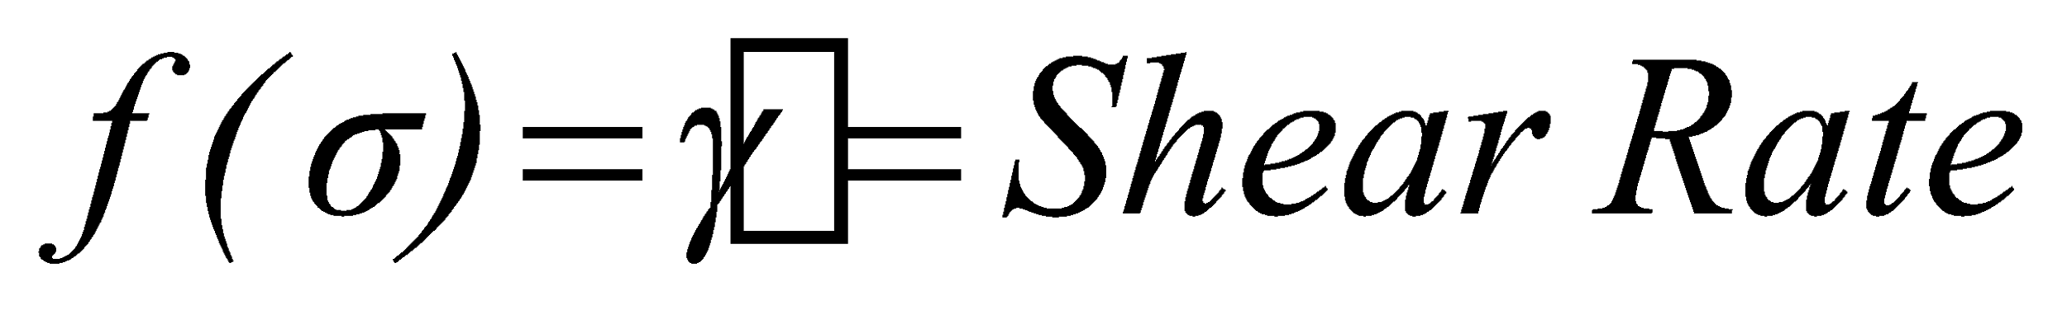
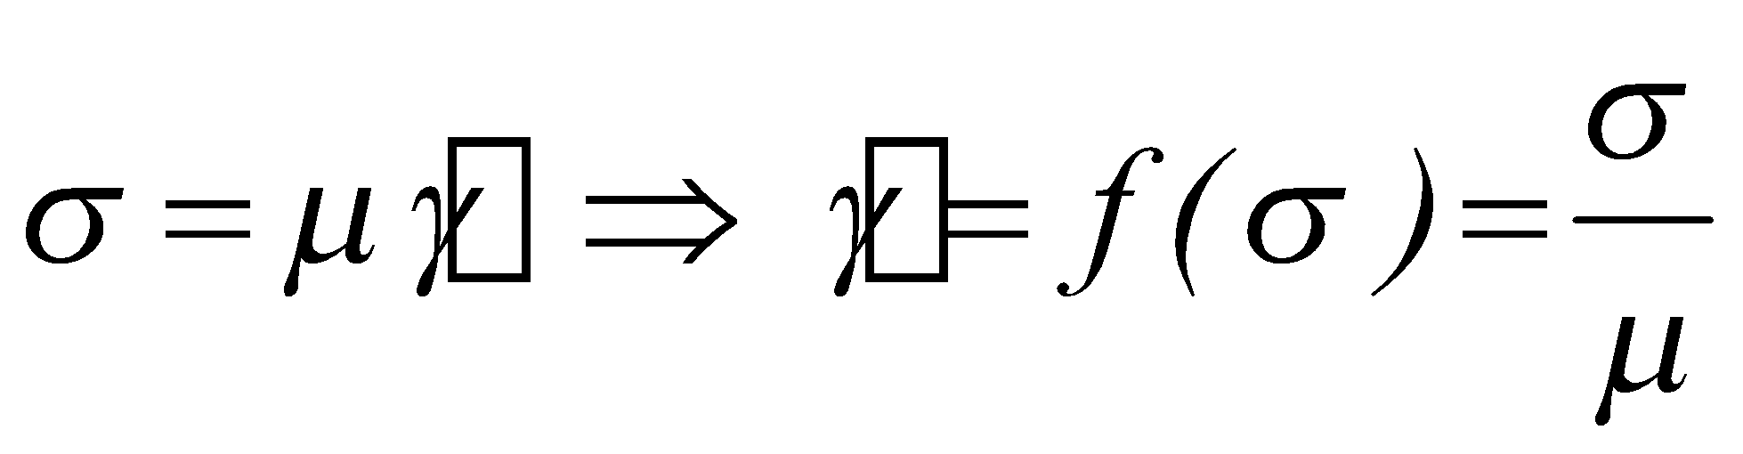
Calculation of Shear Rate
r
R
For a Newtonian Fluid

Slide 21
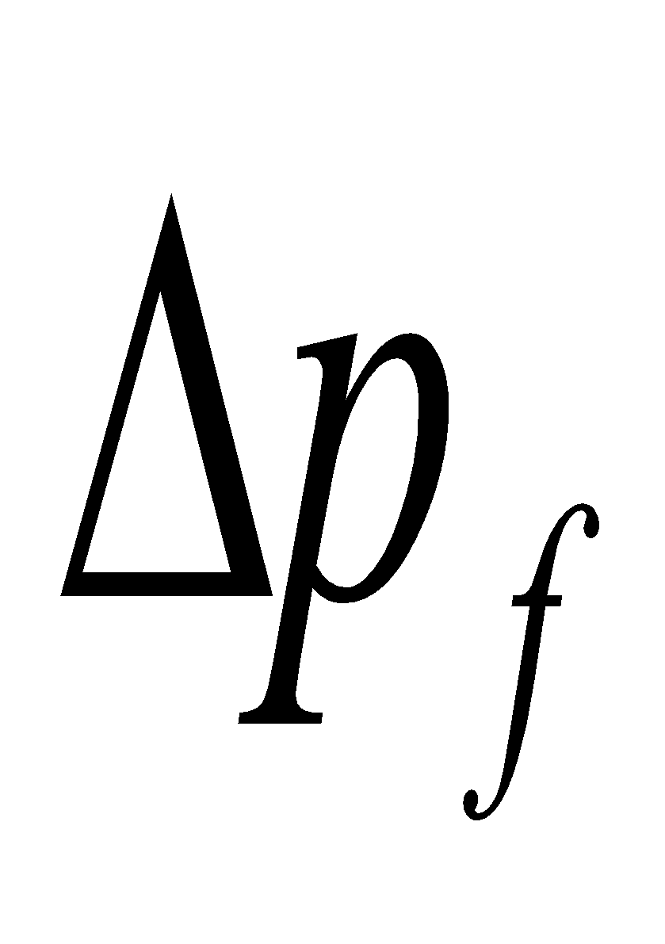
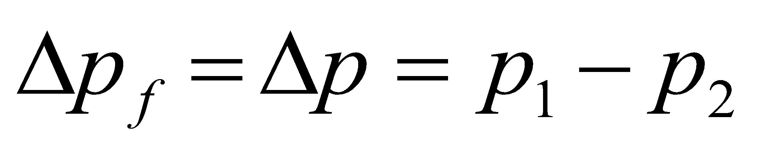
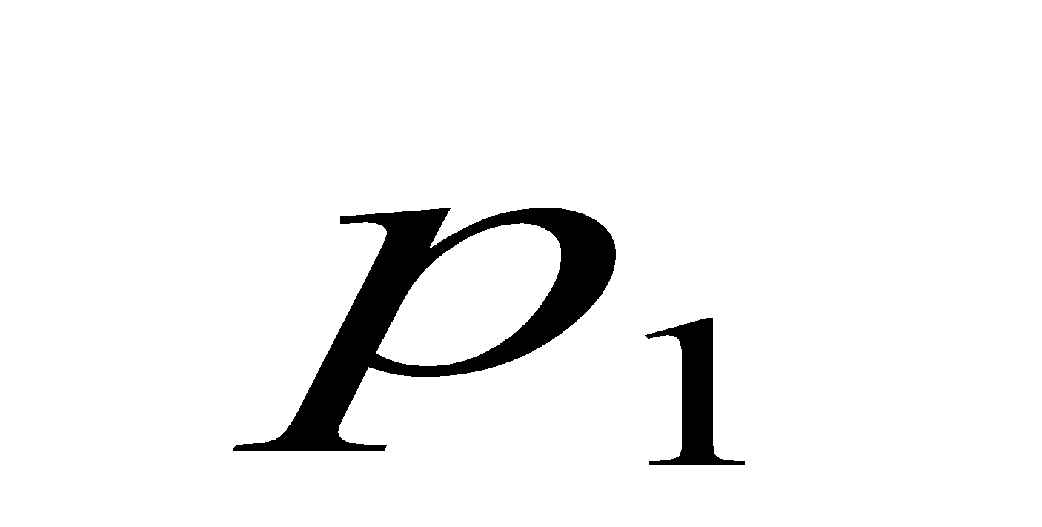
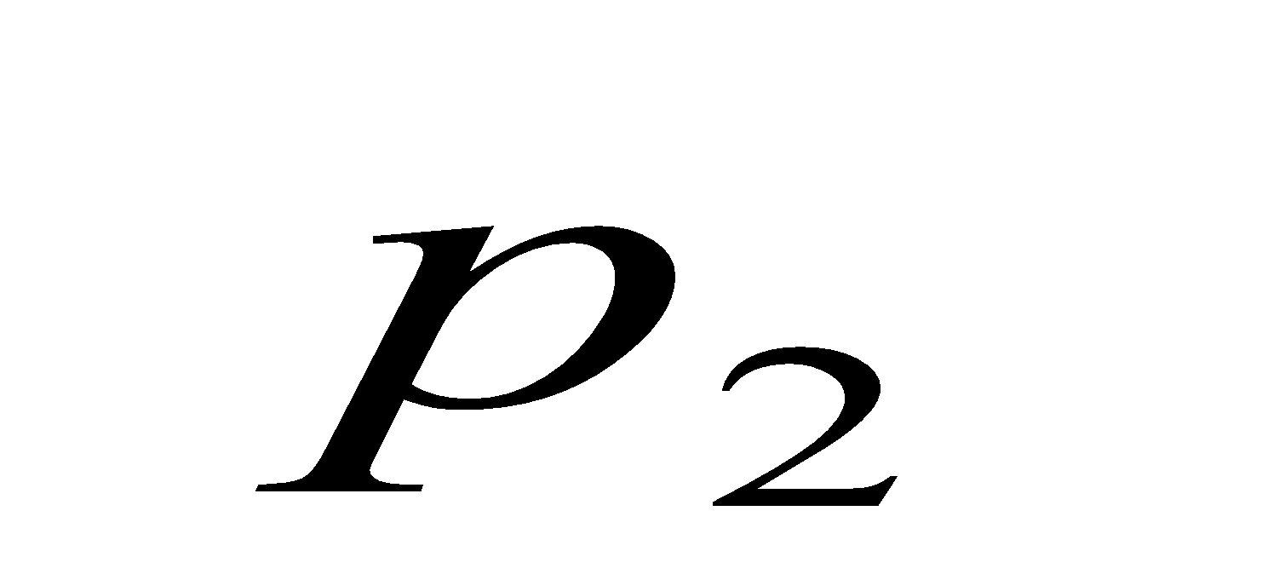









Friction Loss in a Pipe
Q
R
L
Newtonian Fluid
- Shear Stress at the wall
- Shear Rate at the wall
- Pressure Loss
Hagen Poiseuille Eq.

Slide 22










Friction Loss in a Pipe
Power Law Fluid
- Shear Stress at the wall
- Shear Rate at the wall
- Pressure Loss

Slide 23




Non-Newtonian Fluid Phenomena
Flowmeter
p₁
p₂
Q
Let’ assume
same fluid
(same k and n)
same pipe
(same R and L)
For pseudoplastic fluids (n<1) changes in flow rate do not produce large changes in pressure loss, so flowmeters based on pressure loss are not very efficient when used with shear thinning fluids

Slide 24



Non-Newtonian Fluid Phenomena
Effect of Pipe Diameter (or Radius)
Let’s assume
same fluid (same k and n)
same flow rate
constant length
for a Newtonian fluid n=1
A change in pipe radius has less effect on the pressure drop of a shear thinning fluid

